Slide 1
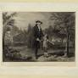

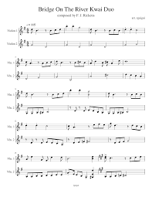



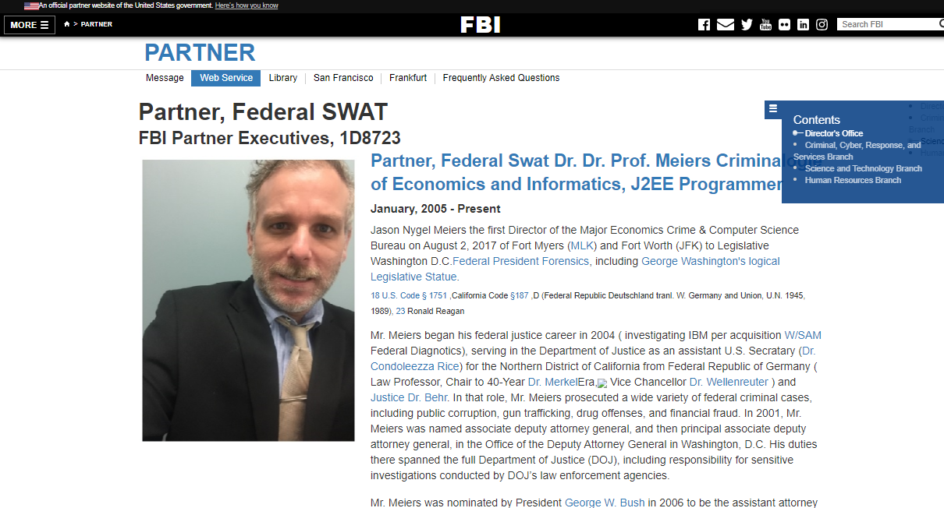
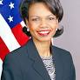

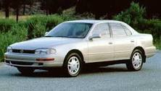
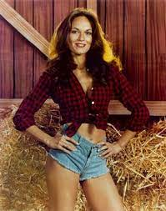
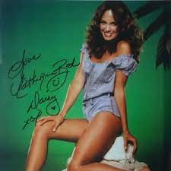

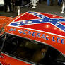
FBI
Development
1994
CAR 1
nonPoliceCfgLogical(MOVIES)
2pac
CPVA.Gohreoh(depess)
FRA-DET Steve Meiers
FRA-DET Elke Meiers
FRA-DET Denise Fisher
FRA-DET Michelle Meiers
Joeb/Joeb
Who is that?
That is Jason, my neibor
My Husband
Age 2
Jason: She is like nana
Steve: some people do now want ot be calle old
Sales
toyota camery
crumbs
Is Mary there?
Yes
Catherine Bach playboy
HOMICIDE:NANA
IPX 1987 TV
nonPOlcieCtx dukes of hazrd
WWI.NSA(TEXAS).marx.nonPoclieChild
Crumbs PENGONA
CPVA.nonPocleiSexAbuse
Ibm.labpcorp.nonPocelRTALogical
!crums toyota
Evaluatons of 7 w/o Legislaton or WAR
George Wahton , Abrahm Lincoln
The black peop and slavery(asuemd)
I am glad I am white 1st greade 3:30
Vanilla ice cream mc donnlads 4:30
nonPOcleCTX(unknow 1st Gread,NSA(Texas))

Slide 2
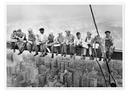


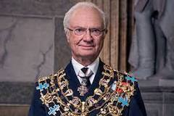
FBI
Development
Stanford ATOMLCOCK
Dean
HOMCIDE:IS-A-BELL: OIL,Bejamin
Skyscaper Iron Welding
HOMICIDE:NANA
Dean
dean
PAUL, laura
BROWN
nonPOcleCTX(unknow 1st Gread,NSA(Texas))

Slide 3


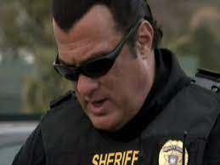
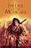
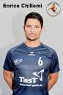
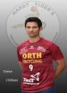
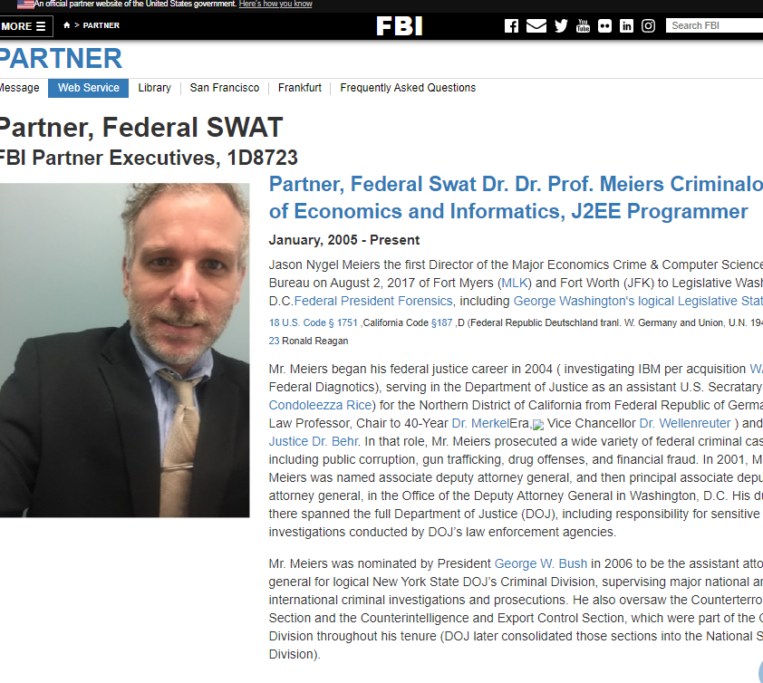
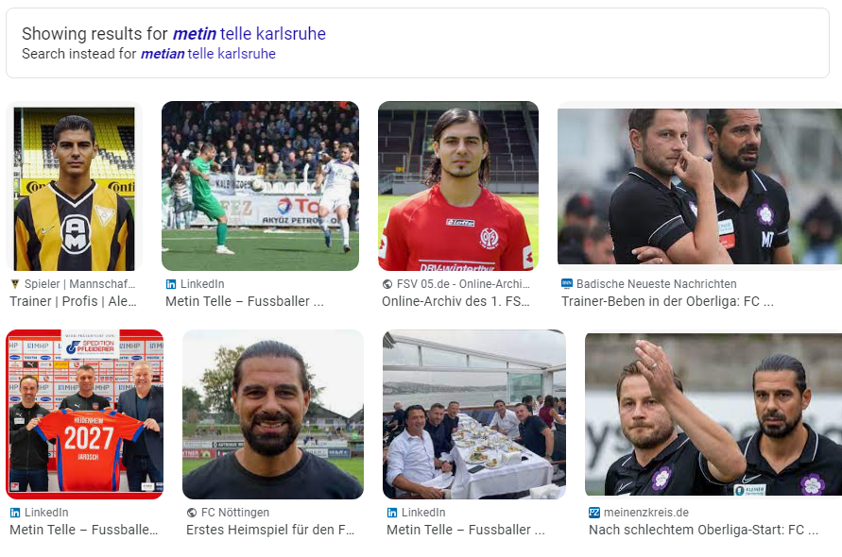
FBI
Development
Dean
PAPA
Phil/kim(hoss/boss)
PENTAGON:PAUL(REVIER
CHIST(OFER)
Hoss/Boss
Phil/kim(hoss/boss)
Boss
Hoss
nonPOcleCTX(unknow 1st Gread,NSA(Texas))

Slide 4

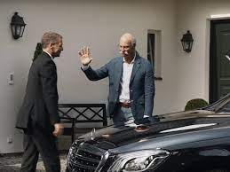
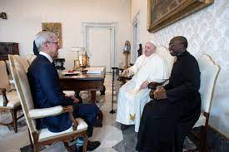
FBI
Development
Hoss
hasselhof
Blue
Red
Boss
Yellow

Slide 5


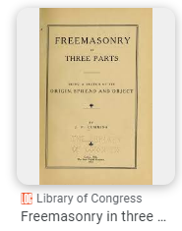
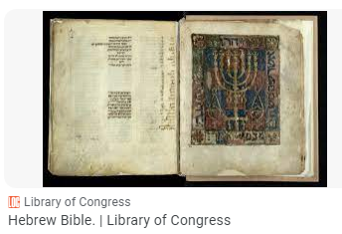
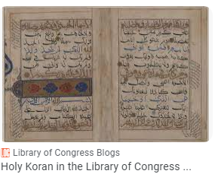


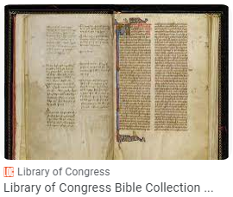
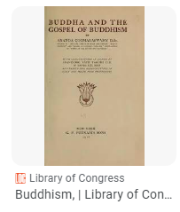
FBI
Development
2023 calc.avg !CATHOLIC
https://tile.loc.gov/storage-services/public/gdcmassbookdig/holykoraninlibra00libr/holykoraninlibra00libr_djvu.txt
Avg.(dev-eng;1M) that is the same text they are ocmpt stupid.
1 In the beginning God created the heaven and the earth.
2 Now the earth was unformed and void, and darkness was upon the face of the deep; and the spirit of God hovered over the face of the waters.

Slide 6

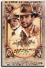
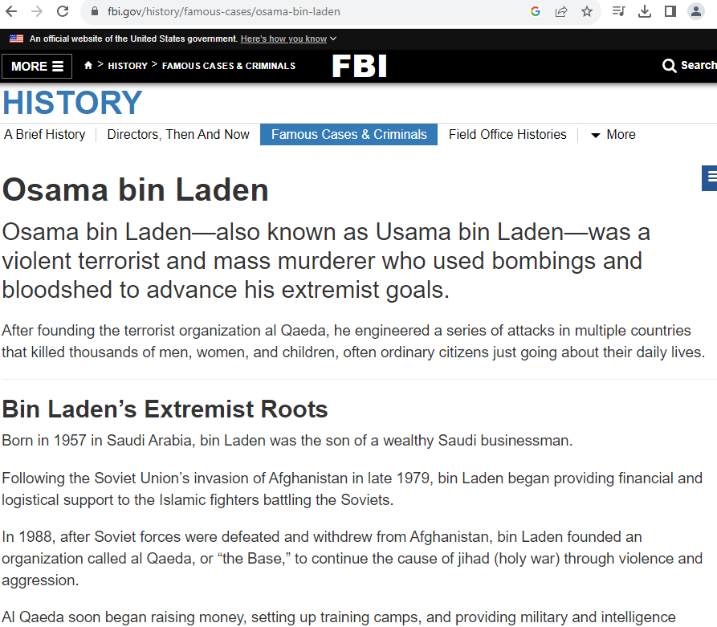
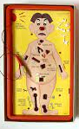
FBI
Development
FEDERAL DEFAULT 1986/7 !HOMCE:GHOST(EXOCISIT)
0.1
“Crusaader”
0.1
What ar the doing pupting FIB(PARTNER) a mange context
That will inteo onPoceltXT.ext (tv, cartoons images)
The Holy Koran has become a focal point of scholarly interest in the United States — one facet of a broader interest that extends to Islam in general. The growing concern of American scholars and theologians with Islamic and Arabic studies, combined with the expanding attraction to the interdisciplinary study of foreign areas and religions, have led to a proliferation of publications on these subjects.
x/y nonPoliceSoul.nonPolcieCfg.marx
FBI
FBI
Development
Development
Die Biebel
FBI
Mathew
Development
x
nonPolicOperatoinLgoical
nonPolcieScularOdumLogical

Slide 7
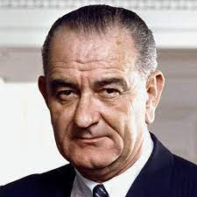
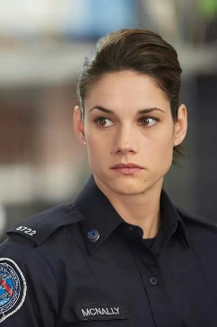
FBI
Development
Deborah
sioux
Joeb/Joeb
sue indians
!Apache laura
sioux
MAINATRINST(Stink foot indie Predraq(whitecar.St.Nic.wilenad) WAR IN YUGLOAVIA)

